Slide 1
Welcome to the unveiling of our latest AI filter enhancements!
Today, we're excited to showcase a range of new filters that broaden the spectrum of artistic expression. From whimsical space adventures to urban winter vibes, our updates cater to a diverse array of themes and styles.

Slide 2
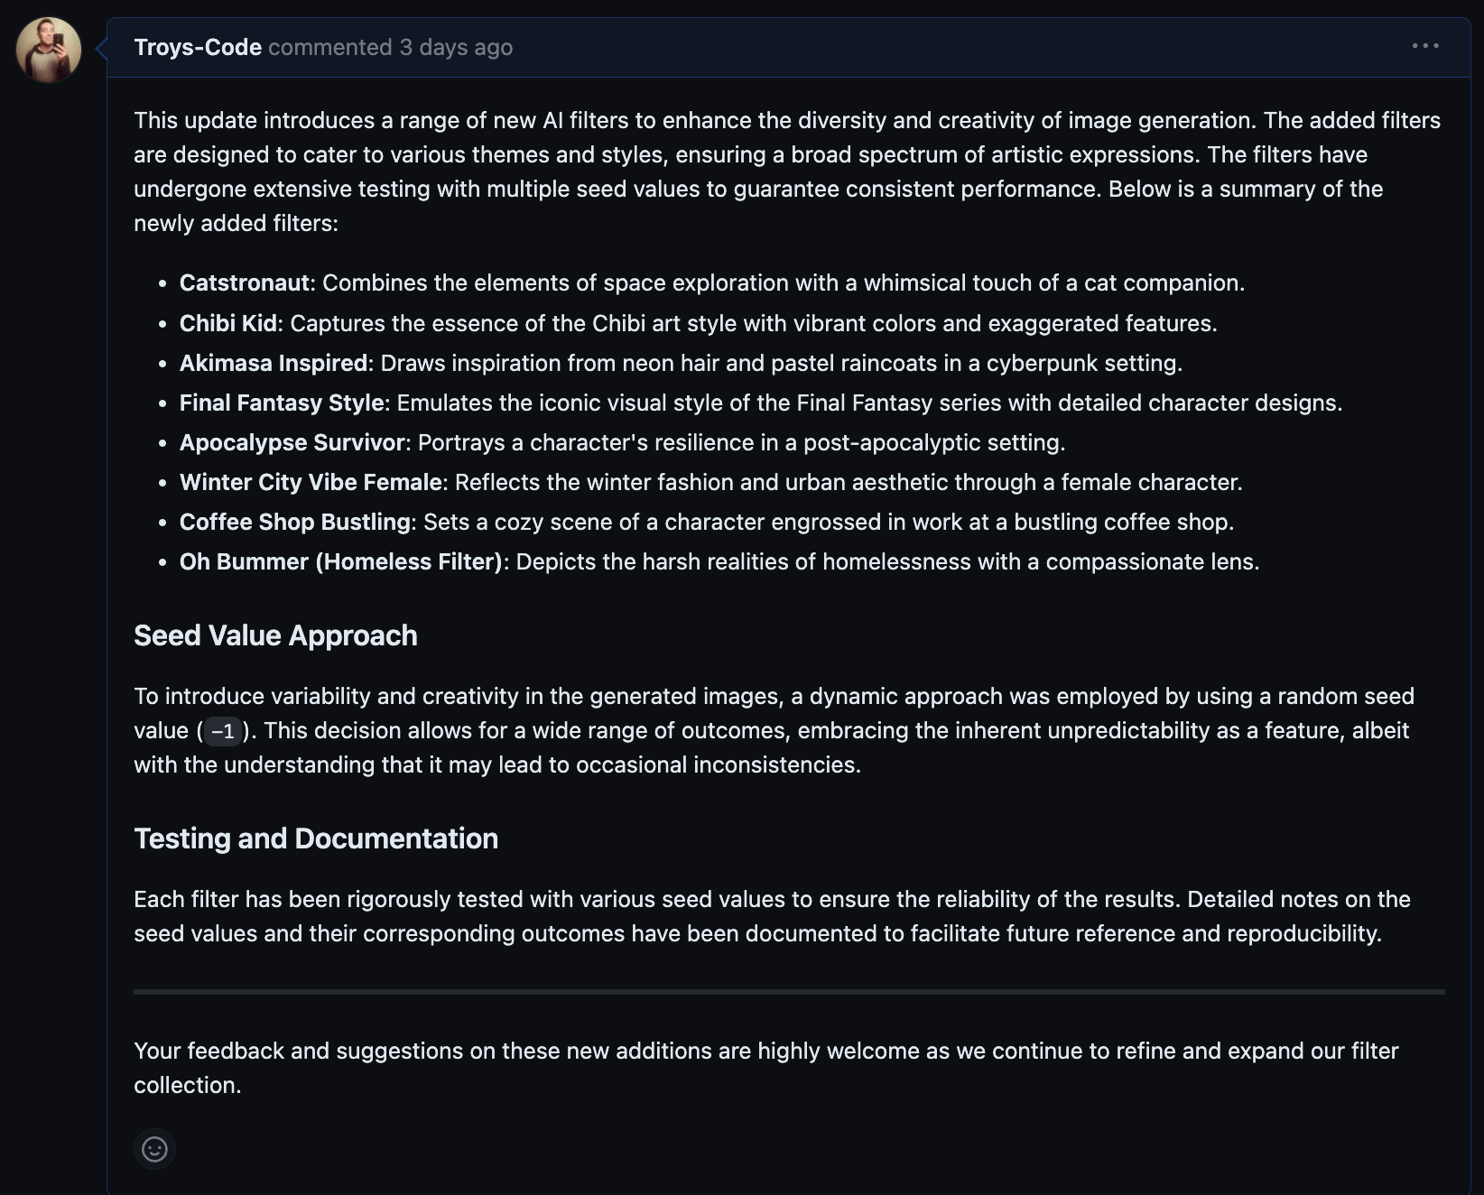

Slide 3
Catstronaut:
Behold the Catstronaut! With our new filter, embark on a space odyssey, combining the charm of cats with the thrill of cosmic exploration. Notice the intricate details of the space gear and the whimsical touch that transforms an everyday scene into an interstellar adventure

Slide 4
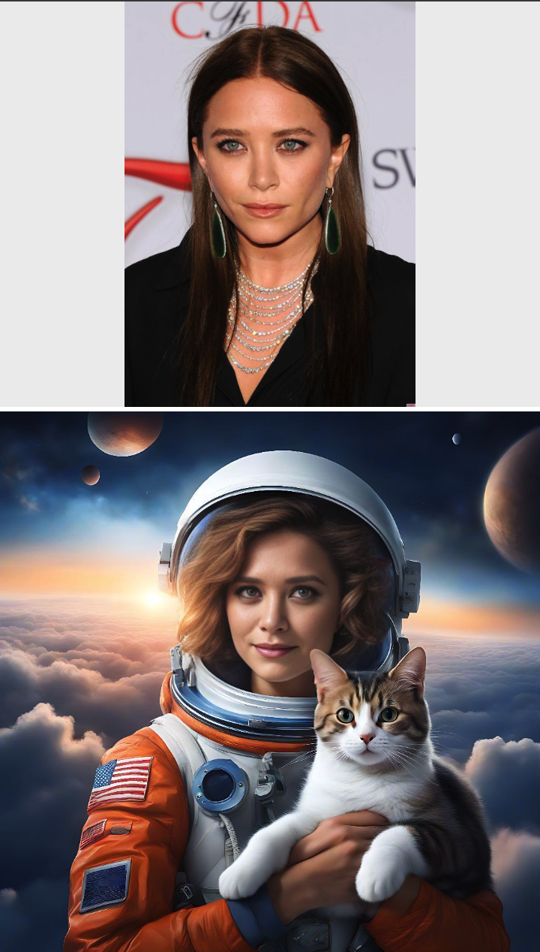
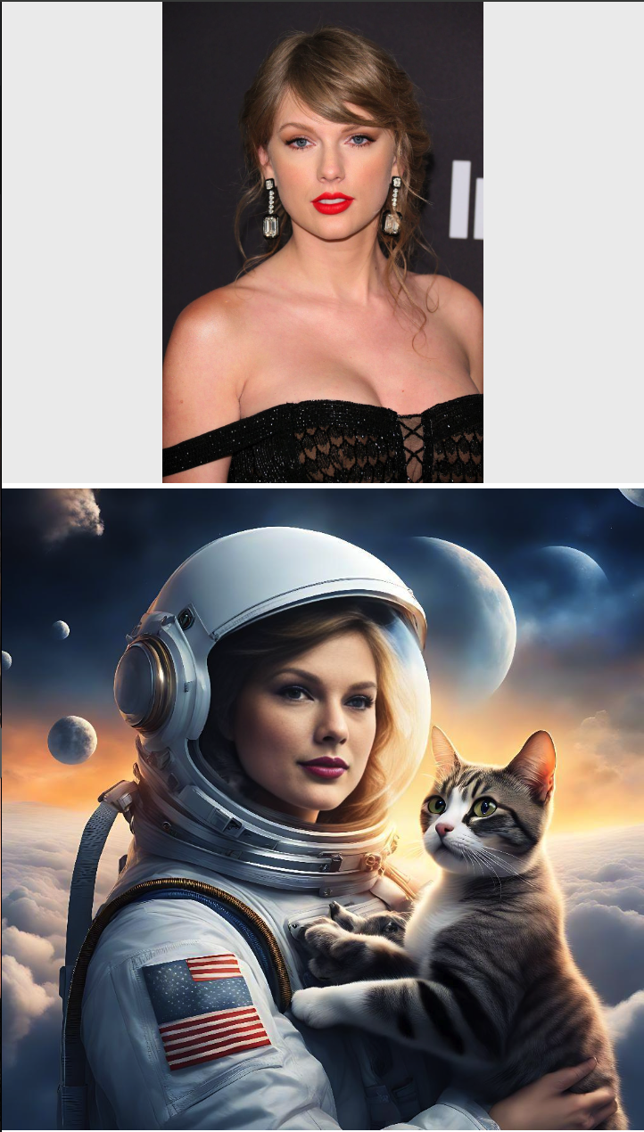
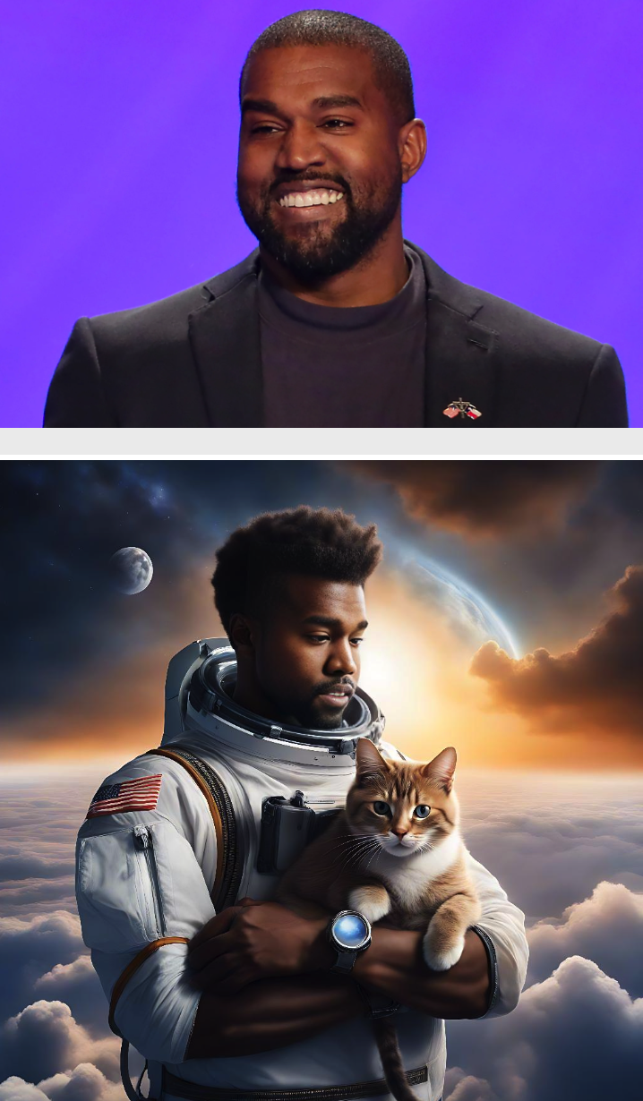

Slide 5
Chibi Kid
Transformed by our Chibi Kid filter, the character now bursts with vibrant colors and exaggerated features, fully embracing the Chibi art style's essence. The result is a more lively and engaging representation, filled with energy and personality.

Slide 6
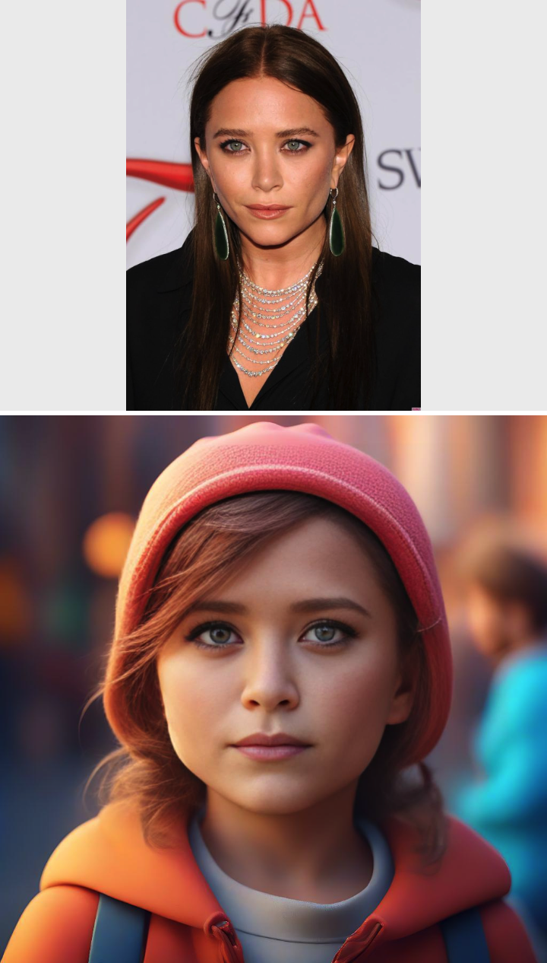
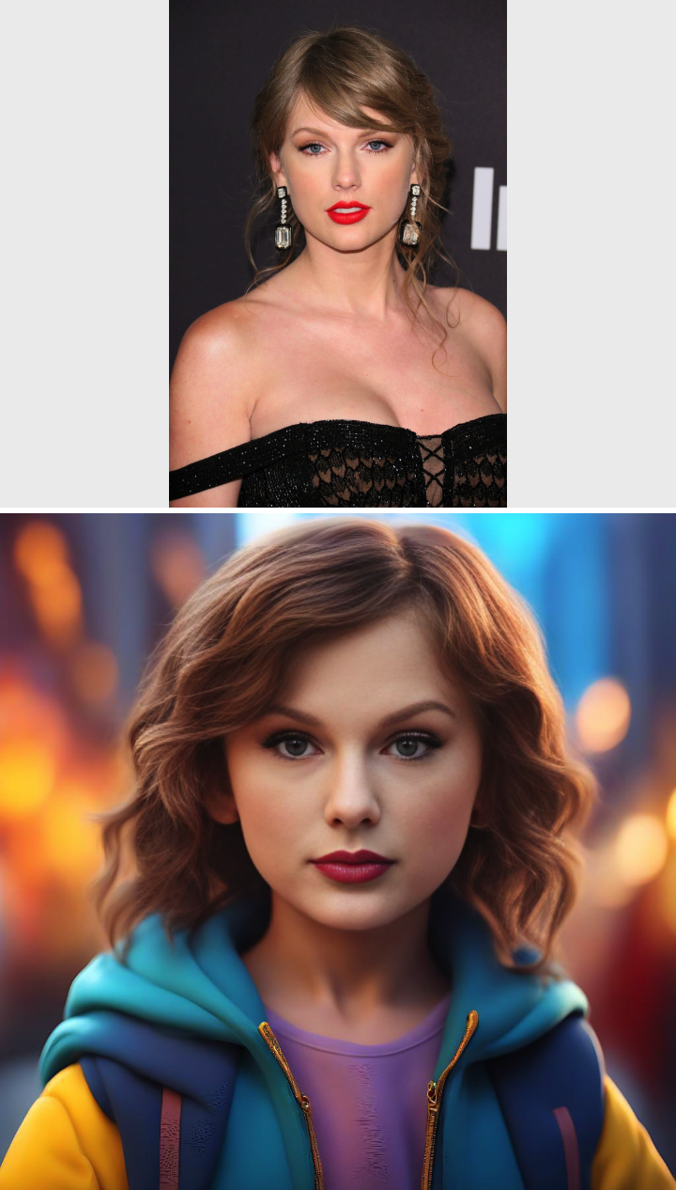


Slide 7
Akimasa Inspired
Enter the Akimasa Inspired filter, where neon hair and pastel raincoats reign supreme. This cyberpunk setting infuses the image with a dynamic and colorful energy, reminiscent of bustling cityscapes at night.

Slide 8
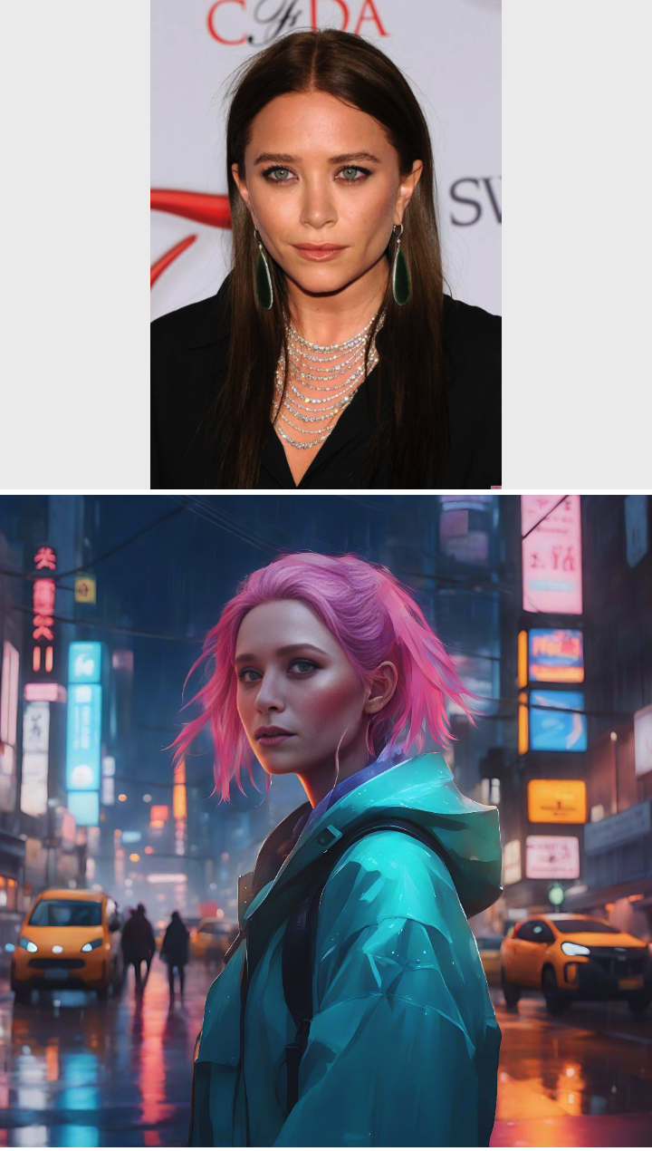
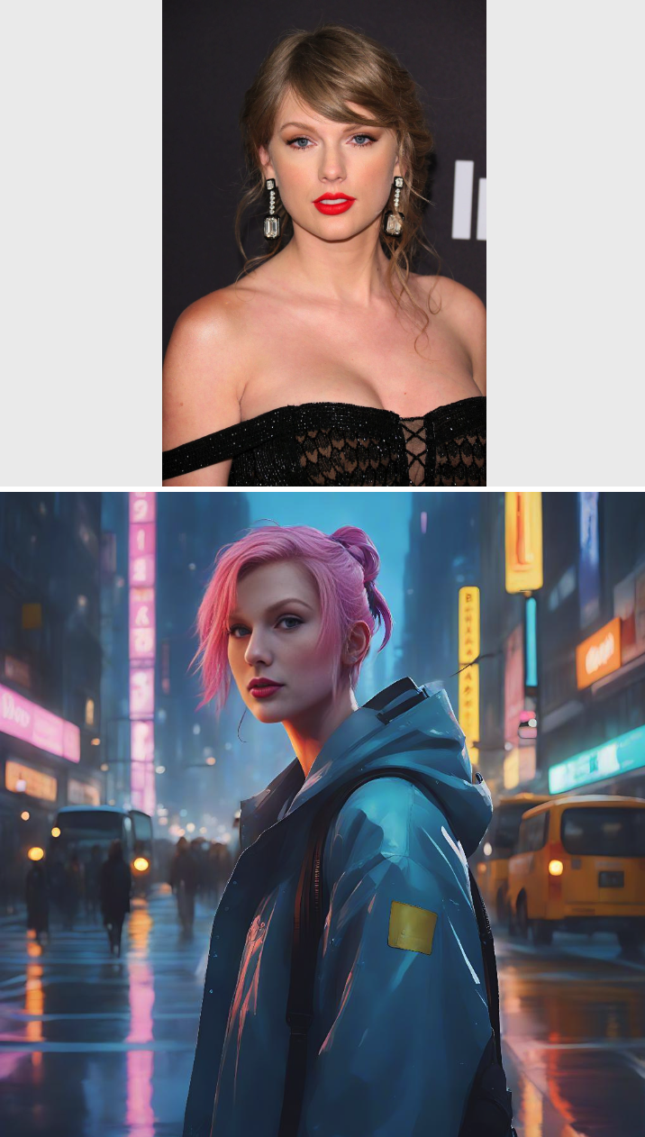
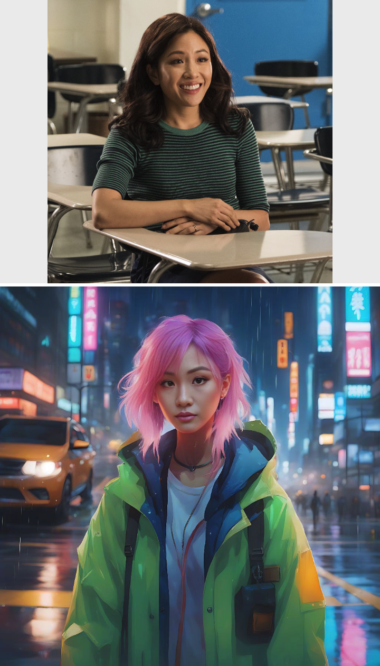

Slide 9
Final Fantasy Style
With the Final Fantasy Style filter, the character is elevated to new heights, mirroring the detailed designs and rich narratives found in the beloved series. Each element is meticulously crafted, from the armor to the mystical surroundings, inviting viewers into a world of adventure.

Slide 10
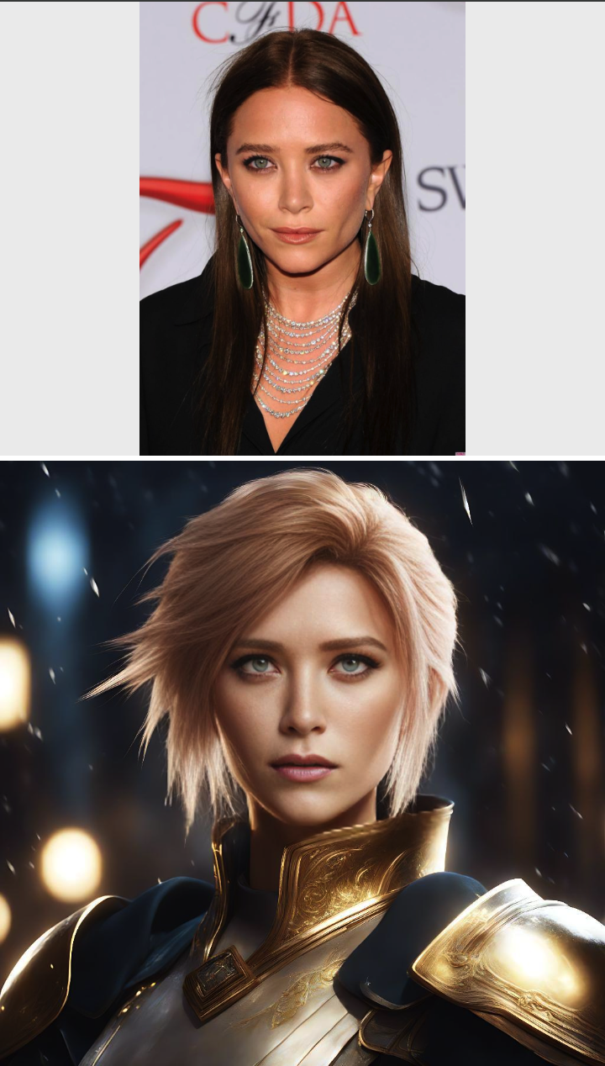
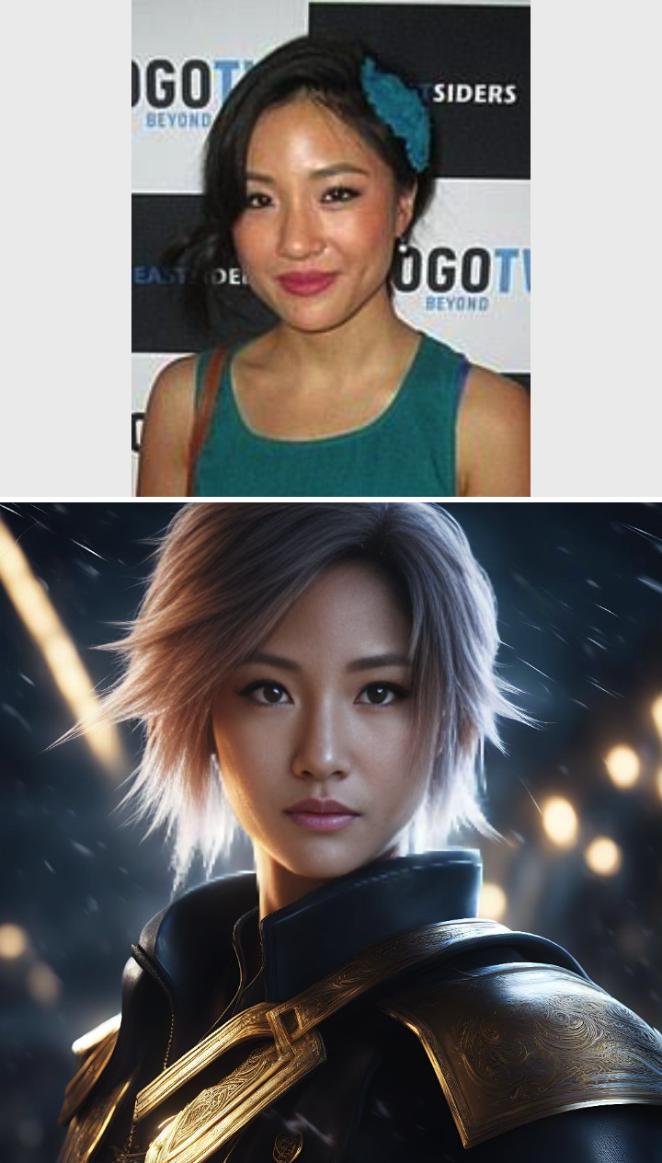
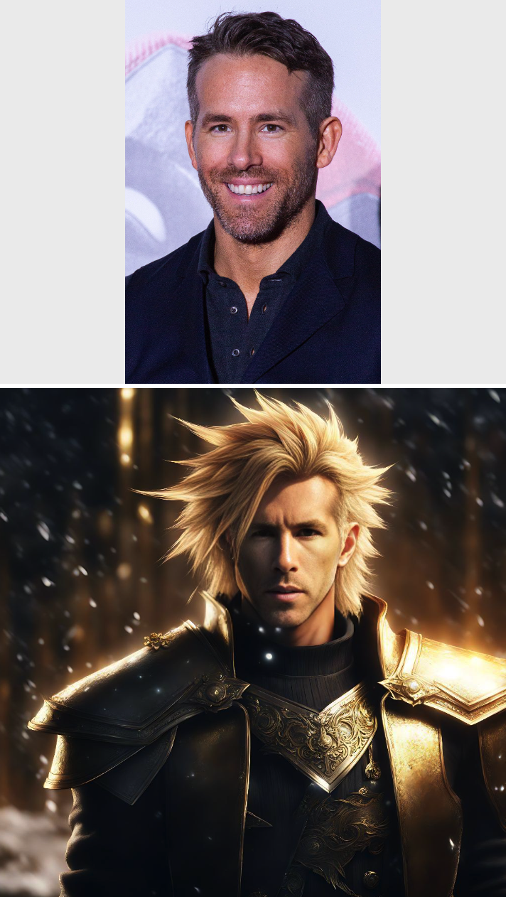

Slide 11
Apocalypse Survivor
Through the lens of our Apocalypse Survivor filter, the scene is transformed into a gripping tale of resilience. The character now stands amid a desolate landscape, a testament to the enduring human spirit in the face of calamity.

Slide 12


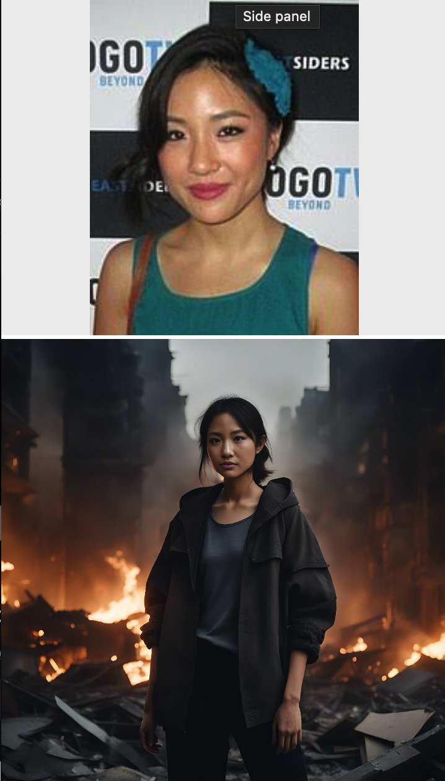

Slide 13
Winter City Vibe Female
The Winter City Vibe Female filter wraps the character in the latest winter fashion, set against an urban backdrop that exudes the cool, crisp atmosphere of the city in winter. The attention to detail in the clothing and the surrounding environment transports the viewer directly into the scene.

Slide 14
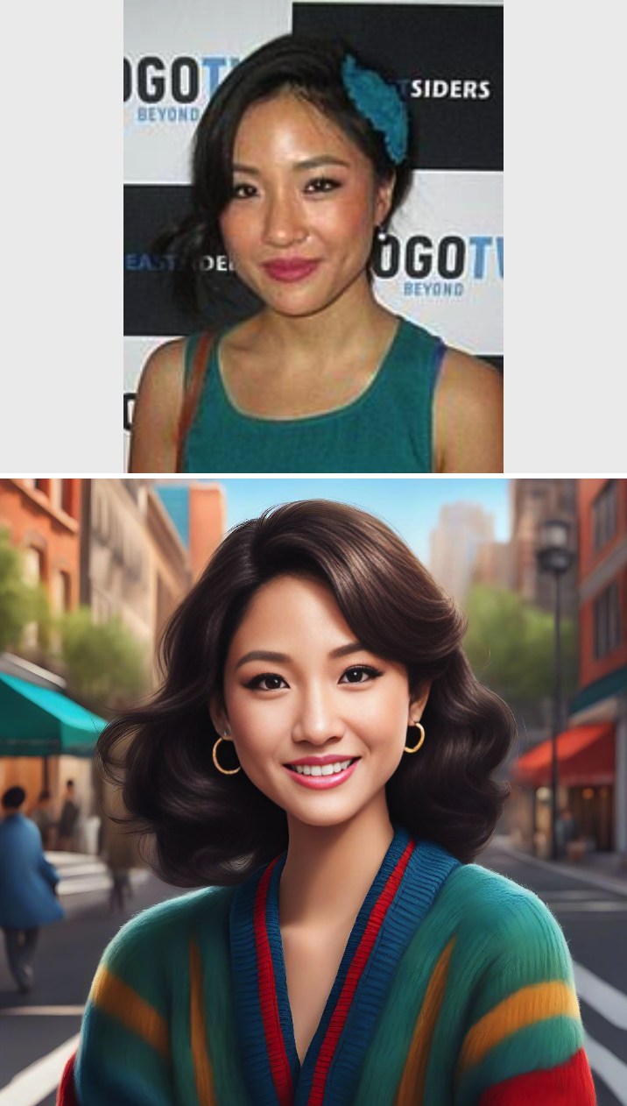
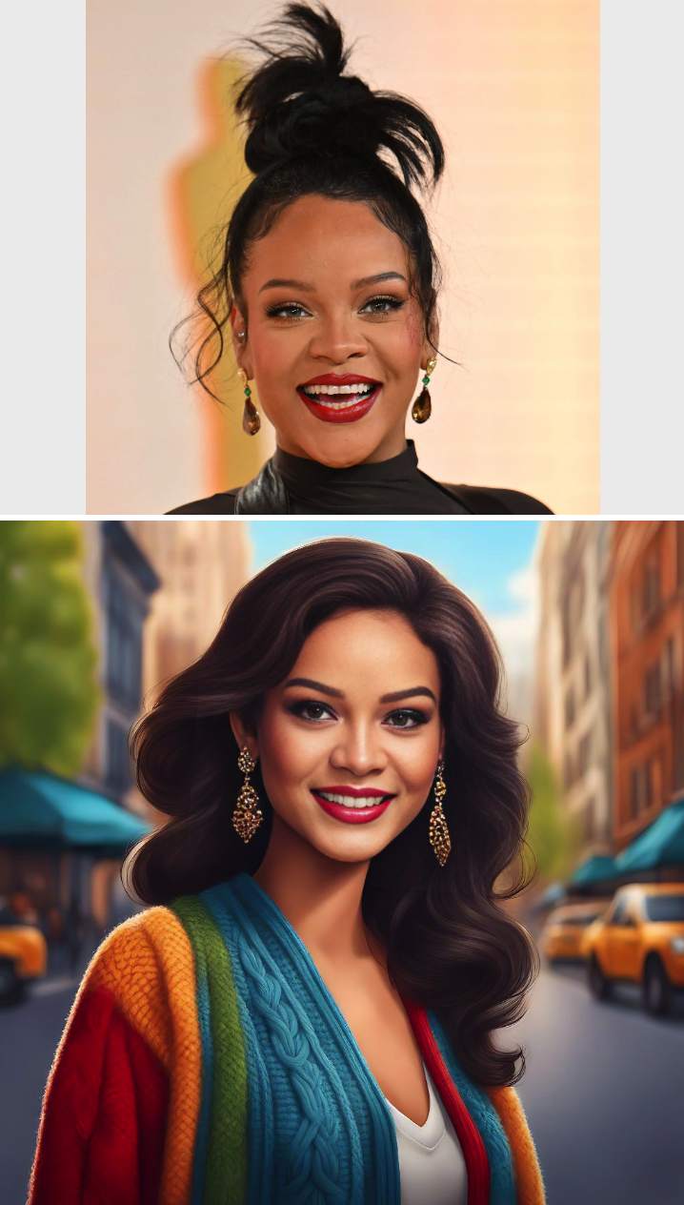
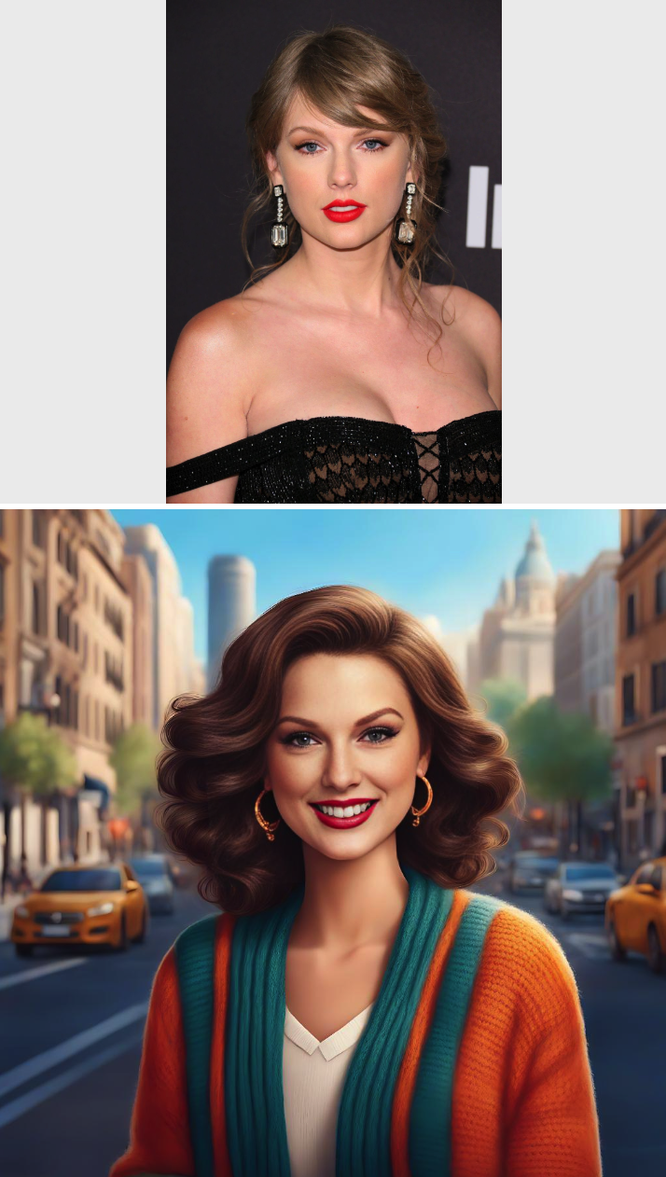

Slide 15
Coffee Shop Bustling
Immerse yourself in the cozy ambiance of a bustling coffee shop. Our filter adds layers of life and activity, creating a scene where the character is deeply engrossed in their work while the world moves vibrantly around them.

Slide 16
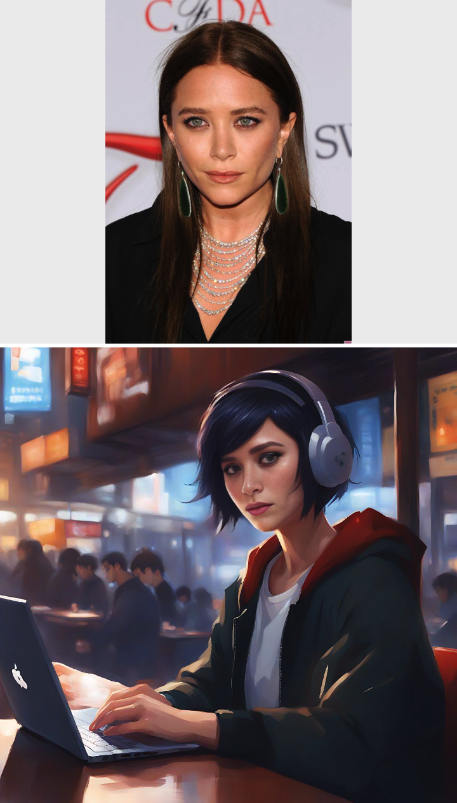
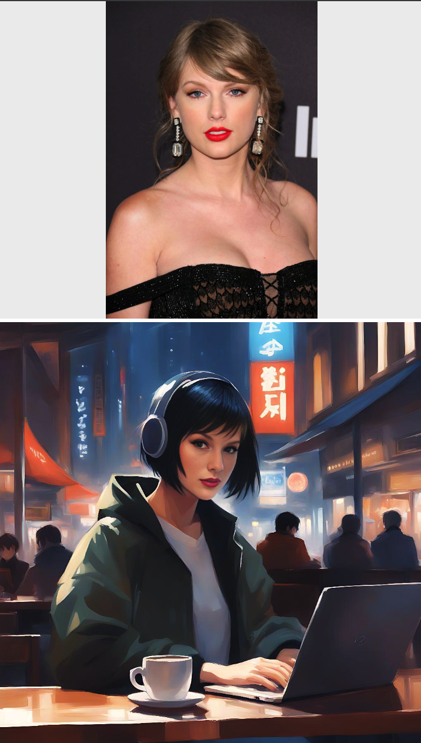
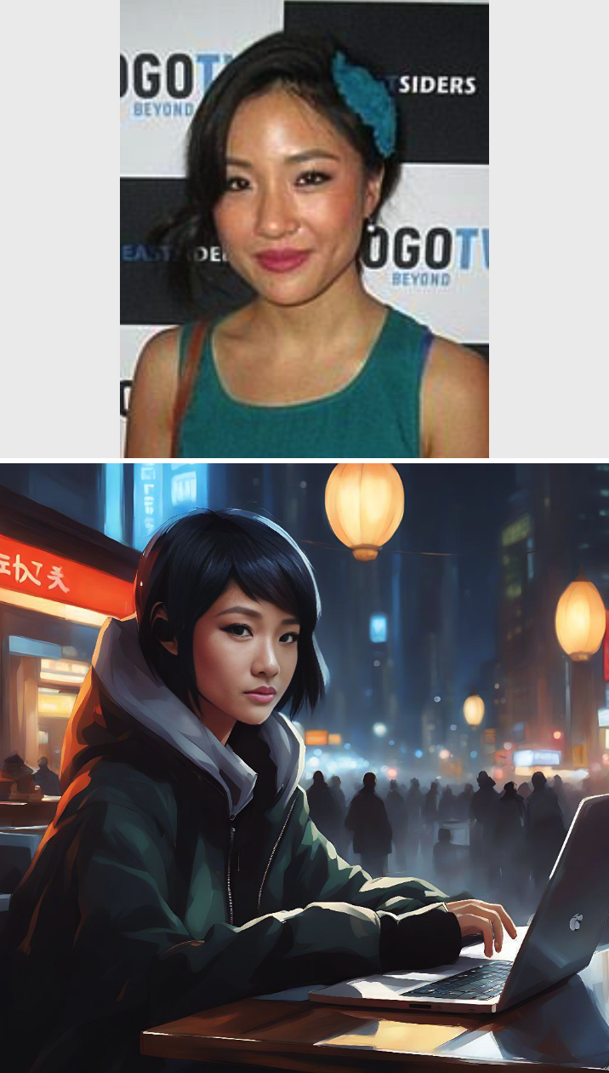

Slide 17
Oh Bummer
(Homeless Filter)
The Oh Bummer filter sheds light on the harsh realities of homelessness, portraying the character with a compassionate lens. The setting and expression tell a compelling story, inviting empathy and understanding from the viewer.

Slide 18

